Slide 1
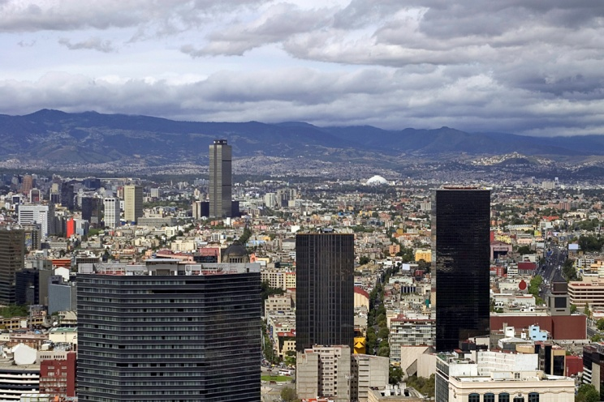

Pressures on water supply?

Slide 2
TASK - Continuum
Cut out the statements on your handout.
Draw the arrow and labels in the margin of your book.
Order the causes of water consumption in order of how damaging they are for water supplies.
Most damaging
Least damaging

Slide 3
Energy: Consumption has increased with population growth and industrial development. Developing countries have vast, untapped HEP resources. But storing water in reservoirs increases the amount of water lost through evaporation and the risks of water related disease.
Tourism: There has been a massive increase in tourism in developing countries. But tourism developments (including hotels and golf courses) take a huge share of a region’s water resources.
Climate Change: Global warming and climate change affect rainfall, evaporation and water availability. Places already suffering from water shortages are likely to experience lower rainfall. The dry areas of developing countries will be hardest hit.
Population Growth: World population grew from 2.5 to 6.2 billion between 1950 and 2000. Water supplies per person decreased by one third from 1970-1990. Seven billion people are likely to have insufficient water by 2050.
Agricultural Demand: Rising population increases the demand for food and the water needed for farming. The area of irrigated land doubled in the twentieth century. Future water shortages could threaten food supplies in many developing countries.
Urbanisation: By 2050 nearly 60% of the world’s population will live in urban areas. The water supply and sanitation infrastructure won’t be able to cope. This will put pressure on governments, especially in LEDCs.
Industrial Development: The growth of manufacturing industry depends on water supplies. Industries such as steel and paper are major water users. They also use rivers and seas to get rid of waste.

Slide 4
Key Term Match Up
Water Stress
Shortages in water occur when demand exceeds supply.
Physical Scarcity
When people simply cannot afford water, even if it readily available.
Many rivers, lakes and groundwater supplies are drying up from overuse. Water stress takes the form of shortages of water supplies, especially for irrigation.
Economic Scarcity

Slide 5
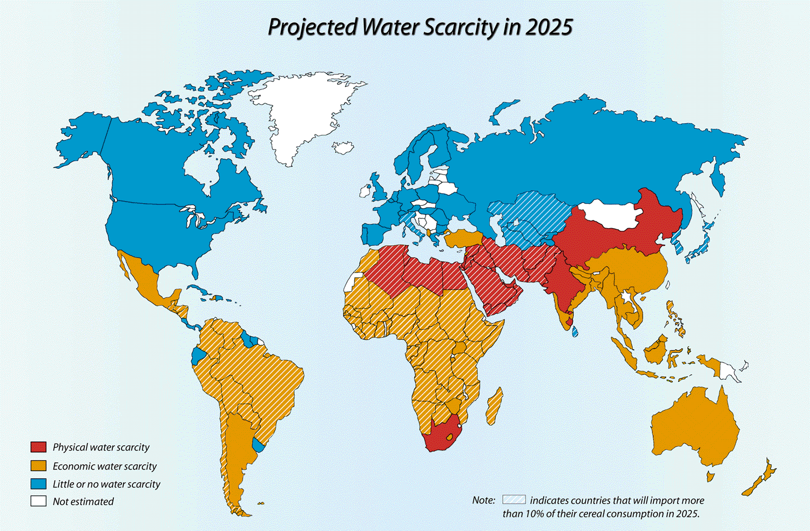
Colour in your map with this information

Slide 6
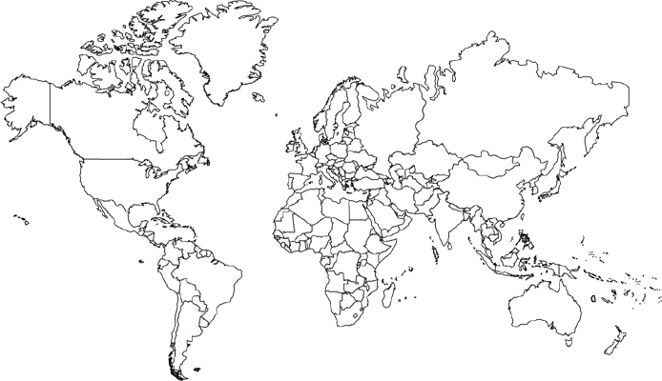
Climate Change and Water Supplies
The impacts on drought:
The impacts on river flow:
The impacts on precipitation and evaporation:
Types | Colour
Physical
Approaching
Economic
Little or No water
No data
Tasks:
Copy the map on page on the white board to show areas of water scarcity using colours.
Create a key to identify types of scarcity.
General impacts of climate change on worlds hydrological systems: naturally water scarce areas may get more drought stressed, but a warmer world also means more evaporation and what goes up must come down! So, as a result, wet places may become even wetter!

Slide 7
Using example(s), describe some of the impacts of climate change on water supplies (4 marks)
Notes:
Create a model answer as a class and write down as we go along.

Slide 8
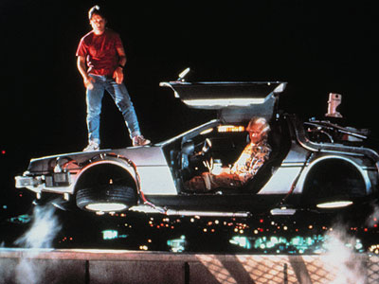
The Future?
Look at the maps on page 63, then answer the following questions:
What impacts could climate change have by 2025?
Why are LEDCs the ones who will be going thirsty?
Imagine: put yourself in a delorean and you are travelling to the year 2038
What will it be like?

